Slide 1

Linear Search, Binary Search
Data Structure | Searching and Sorting
Course: Data Structure | Chapter: Searching and Sorting | Bachelor of Engineering
DISCOVER · LEARN · EMPOWER
Notes:
Welcome everyone to today's lecture on Searching and Sorting. We will focus specifically on Linear Search and Binary Search algorithms. These are fundamental techniques every engineer must master for efficient data retrieval. Remember, the choice of algorithm depends heavily on whether your data is sorted or not.

Slide 2
Course Outcomes
SLIDE 2 / 10
Course Outcome
CO | BT LEVEL | DESCRIPTION
CO1 | BT1 | Understand and apply basic data structures, algorithms, complexity analysis, ADTs, arrays and linked lists.
CO2 | BT2 | Apply and implement stacks and queues in problem-solving.
CO3 | BT3 | Analyse and apply searching, sorting, and hashing techniques.
CO4 | BT4 | Construct and apply tree structures and traversal techniques.
CO5 | BT5 | Represent and solve graph problems using DFS, BFS, and graph algorithms.
Chandigarh University
2 / 10
Notes:
Today's lecture directly addresses Course Outcome 3, where you will analyze and apply searching techniques like Linear and Binary search. Although we focus on linear arrays here, these concepts lay the groundwork for CO4, which involves tree structures and traversal. Understanding these basic search methods is a prerequisite for mastering complex tree traversals later in the course.

Slide 3
Learning Objectives
SLIDE 3 / 10
Learning Outcomes
1
Define Linear Search and explain its sequential scanning mechanism.
2
Analyze the time complexity of Linear Search as O(n).
3
Define Binary Search and explain its divide-and-conquer approach.
4
Evaluate the strict requirement of sorted data for Binary Search.
5
Compare the efficiency of both algorithms using a numerical example.
Chandigarh University
3 / 10
Notes:
By the end of this session, you will be able to define both search methods clearly. You will analyze why Linear Search is slow for large datasets but simple to implement. We will also evaluate how Binary Search drastically reduces comparisons by half at each step. Finally, we will compare their efficiency using a concrete numerical example to see the difference in performance.

Slide 4
Lecture
SLIDE 4 / 10
Linear Search Mechanism
1
Linear Search scans every element sequentially from the start of the array.
2
The algorithm compares the target key with each element until a match is found.
3
If the key is found, the index is returned; otherwise, it returns -1.
4
This method works on both sorted and unsorted arrays without restrictions.
5
The worst-case scenario occurs when the target is the last element or absent.
Chandigarh University
4 / 10
Notes:
Imagine you are looking for a specific name in a phone book that is not sorted alphabetically. You must check every single entry one by one. For example, if we search for the number 42 in an array of 100 numbers, we might check all 100 elements if 42 is at the very end. This sequential checking is the defining characteristic of Linear Search.

Slide 5
Lecture
SLIDE 5 / 10
Linear Search Complexity
1
Best case time complexity is O(1) when the target is the first element.
2
Average case time complexity is O(n) for a random target position.
3
Worst case time complexity is O(n) when the target is at the end.
4
Space complexity is O(1) as it requires no extra memory allocation.
5
The number of comparisons grows linearly with the size of the input array.
Chandigarh University
5 / 10
Notes:
Let's look at the math behind the speed. If you have an array of 1,000 elements, in the worst case, you perform 1,000 comparisons. This is why we say the complexity is O(n). Even if the array doubles in size, the time taken roughly doubles. This linear growth makes it inefficient for very large datasets compared to other methods.

Slide 6
Lecture
SLIDE 6 / 10
Binary Search Principle
1
Binary Search requires the input array to be sorted in ascending or descending order.
2
It compares the target key with the middle element of the current search range.
3
If the key matches the middle, the search terminates successfully immediately.
4
If the key is smaller, the search continues in the left half of the array.
5
If the key is larger, the search continues in the right half of the array.
Chandigarh University
6 / 10
Notes:
Think of looking up a word in a dictionary. You don't start from page one; you open the book in the middle. If the word you want comes before the middle word, you discard the entire second half. You repeat this process, cutting the search space in half every single time. This divide-and-conquer strategy is the core of Binary Search.

Slide 7
Lecture
SLIDE 7 / 10
Binary Search Complexity
1
Best case time complexity is O(1) if the target is the middle element.
2
Average and worst case time complexity is O(log n) for the algorithm.
3
The search space reduces by half in every iteration of the loop.
4
Space complexity is O(1) for iterative implementation or O(log n) for recursive.
5
It is significantly faster than Linear Search for large sorted datasets.
Chandigarh University
7 / 10
Notes:
The power of Binary Search lies in its logarithmic time complexity. For an array of 1,000 elements, you need at most 10 comparisons because 2 to the power of 10 is 1024. In contrast, Linear Search might need 1,000 comparisons. As the data grows to a million elements, Binary Search still only needs about 20 comparisons, making it incredibly efficient.

Slide 8
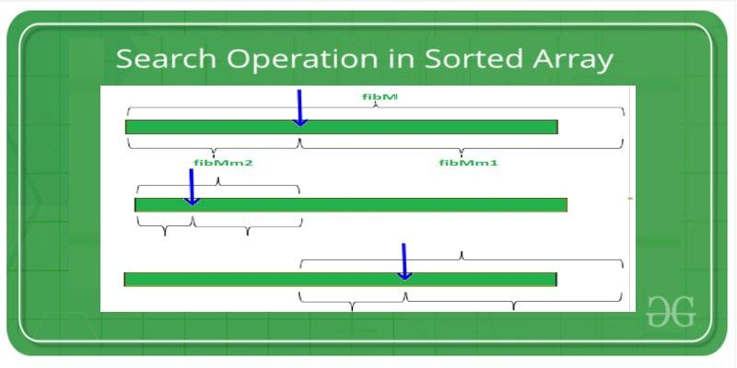
Lecture
SLIDE 8 / 10
Worked Numerical Example
ARRAY
[2, 5, 8, 12, 16, 23, 38, 45, 56, 67] and Target: 23.
TOTAL COMPARISONS REQUIRED
3 out of 10 elements in the array.
• Iteration 1: Middle index is 4 (value 16); 23 > 16, search right half.
• Iteration 2: New range [23, 38, 45, 56, 67]; Middle is 38; 23 < 38, search left.
• Iteration 3: New range [23]; Middle is 23; Match found at index 5.
Source: media.geeksforgeeks.org
Chandigarh University
8 / 10
Notes:
Let's trace this example together. We start with the full array and look at the middle element, which is 16. Since 23 is greater than 16, we ignore the left side and focus on the right. We then check the middle of that new range, which is 38. Since 23 is smaller, we go left again. Finally, we find 23 in just three steps, demonstrating the efficiency of the algorithm.

Slide 9
Lecture
SLIDE 9 / 10
Key Takeaways
1
Linear Search is simple but slow, with O(n) complexity for all cases.
2
Binary Search is fast with O(log n) complexity but requires sorted data.
3
Linear Search works on any array, while Binary Search needs pre-sorted input.
4
Binary Search reduces the search space by half in every single iteration.
5
Choose Linear Search for small or unsorted data; choose Binary Search for large sorted data.
Chandigarh University
9 / 10
Notes:
To summarize, remember that Linear Search is your go-to for unsorted or small lists because it is easy to implement. However, for large datasets, always sort the data first to use Binary Search for maximum speed. The key difference is the requirement for sorted data and the resulting difference in time complexity. Mastering both allows you to choose the right tool for any engineering problem.

Slide 10
Lecture
SLIDE 10 / 10
References
DATA STRUCTURES
A Pseudocode Approach with C — Gilberg, Forouzan
• Data Structures — Lipschutz
• Data Structure Using C — AK Sharma
• C and Data structure — P. S. Deshpandey
Chandigarh University
10 / 10
Notes:
These four textbooks provide comprehensive coverage of the topics discussed today. I recommend Gilberg and Forouzan for a strong pseudocode foundation, and Lipschutz for clear conceptual explanations. AK Sharma and Deshpandey offer excellent C-language implementations for practical coding exercises. Please refer to these books for deeper insights and additional practice problems.

